Slide 1
Figures – Chapter 15

Slide 2
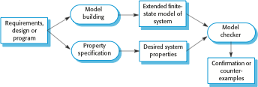
Figure 15.1 Model checking

Slide 3
Figure 15.2 Automated static analysis checks
Fault class | Static analysis check
Data faults | Variables used before initialization Variables declared but never used Variables assigned twice but never used between assignments Possible array bound violations Undeclared variables
Control faults | Unreachable code Unconditional branches into loops
Input/output faults | Variables output twice with no intervening assignment
Interface faults | Parameter-type mismatches Parameter number mismatches Non-usage of the results of functions Uncalled functions and procedures
Storage management faults | Unassigned pointers Pointer arithmetic Memory leaks

Slide 4

Figure 15.3 Reliability measurement

Slide 5
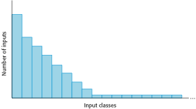
Figure 15.4 An operational profile

Slide 6
Figure 15.5 Examples of entries in a security checklist
Security checklist
1. Do all files that are created in the application have appropriate access permissions? The wrong access permissions may lead to these files being accessed by unauthorized users.
2. Does the system automatically terminate user sessions after a period of inactivity? Sessions that are left active may allow unauthorized access through an unattended computer.
3. If the system is written in a programming language without array bound checking, are there situations where buffer overflow may be exploited? Buffer overflow may allow attackers to send code strings to the system and then execute them.
4. If passwords are set, does the system check that passwords are ‘strong’? Strong passwords consist of mixed letters, numbers, and punctuation, and are not normal dictionary entries. They are more difficult to break than simple passwords.
5. Are inputs from the system’s environment always checked against an input specification? Incorrect processing of badly formed inputs is a common cause of security vulnerabilities.

Slide 7
Figure 15.6 A simplified hazard log entry
Hazard Log Page 4: Printed 20.02.2009
System: Insulin Pump System Safety Engineer: James Brown |  |  |  | File: InsulinPump/Safety/HazardLog Log version: 1/3
Identified Hazard | Insulin overdose delivered to patient
Identified by | Jane Williams
Criticality class | 1
Identified risk | High
Fault tree identified | YES | Date | 24.01.07 |  | Location | Hazard Log, Page 5
Fault tree creators | Jane Williams and Bill Smith
Fault tree checked | YES | Date | 28.01.07 |  | Checker | James Brown
System safety design requirements
1. The system shall include self-testing software that will test the sensor system, the clock, and the insulin delivery system.
2. The self-checking software shall be executed once per minute.
3. In the event of the self-checking software discovering a fault in any of the system components, an audible warning shall be issued and the pump display shall indicate the name of the component where the fault has been discovered. The delivery of insulin shall be suspended.
4. The system shall incorporate an override system that allows the system user to modify the computed dose of insulin that is to be delivered by the system.
5. The amount of override shall be no greater than a pre-set value (maxOverride), which is set when the system is configured by medical staff.

Slide 8
Figure 15.7 The contents of a software safety case
Chapter | Description
System description | An overview of the system and a description of its critical components.
Safety requirements | The safety requirements abstracted from the system requirements specification. Details of other relevant system requirements may also be included.
Hazard and risk analysis | Documents describing the hazards and risks that have been identified and the measures taken to reduce risk. Hazard analyses and hazard logs.
Design analysis | A set of structured arguments (see Section 15.5.1) that justify why the design is safe.
Verification and validation | A description of the V & V procedures used and, where appropriate, the test plans for the system. Summaries of the test results showing defects that have been detected and corrected. If formal methods have been used, a formal system specification and any analyses of that specification. Records of static analyses of the source code.
Review reports | Records of all design and safety reviews.
Team competences | Evidence of the competence of all of the team involved in safety-related systems development and validation.
Process QA | Records of the quality assurance processes (see Chapter 24) carried out during system development.
Change management processes | Records of all changes proposed, actions taken and, where appropriate, justification of the safety of these changes. Information about configuration management procedures and configuration management logs.
Associated safety cases | References to other safety cases that may impact the safety case.

Slide 9
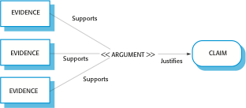
Figure 15.8 Structured arguments

Slide 10
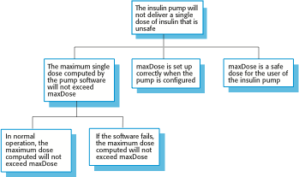
Figure 15.9 A safety claim hierarchy for the insulin pump

Slide 11
Figure 15.10 Insulin dose computation with safety checks
-- The insulin dose to be delivered is a function of blood sugar level,
-- the previous dose delivered and the time of delivery of the previous dose
currentDose = computeInsulin () ;
// Safety check—adjust currentDose if necessary.
// if statement 1
if (previousDose == 0)
{
if (currentDose > maxDose/2)
currentDose = maxDose/2 ;
}
else
if (currentDose > (previousDose * 2) )
currentDose = previousDose * 2 ;
// if statement 2
if ( currentDose < minimumDose )
currentDose = 0 ;
else if ( currentDose > maxDose )
currentDose = maxDose ;
administerInsulin (currentDose) ;

Slide 12
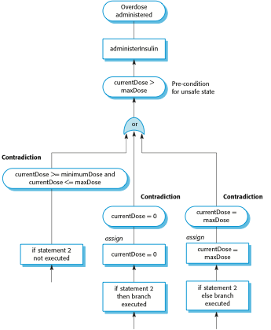
Figure 15.11 Informal safety argument based on demonstrating contradictions

Slide 13
Figure 15.12 Door entry code
1 entryCode = lock.getEntryCode () ; 2 if (entryCode == lock.authorizedCode)
3 {
4 shieldStatus = Shield.getStatus (); 5 radiationLevel = RadSensor.get ();
6 if (radiationLevel < dangerLevel) 7 state = safe; 8 else 9 state = unsafe;
10 if (shieldStatus == Shield.inPlace() ) 11 state = safe;
12 if (state == safe)
13 {
14 Door.locked = false ; 15 Door.unlock ();
16 }
17 else
18 {
19 Door.lock ( ); 20 Door.locked := true ;
21 }
22 }

